Slide 1

IMPLEMENTION OF MST USING C
Virti Pratikkumar Shah
Roll no:2
Branch:CE
Enrollement no:21002170110208
Batch:S1

Slide 2
Introduction
A Minimum Spanning Tree(MST) or minimum weight spanning tree for a weighted, connected, undirected graph is a spanning tree having a weight less than or equal to the weight of every other possible spanning tree. The weight of a spanning tree is the sum of weights given to each edge of the spanning tree.
Necessary conditions for Minimum Spanning Tree:
It must not form a cycle i.e. , no edge is traversed twice.
There must be no other spanning tree with lesser weight.
Algorithms for finding Minimum Spanning Tree(MST):
Kruskal Algorithm
In Kruskal's algorithm, we start from edges with the lowest weight and keep adding the edges until the goal is reached.
2. Prim’s Algorithm
Prim's algorithm starts with the single node and explores all the adjacent nodes with all the connecting edges at every step. The edges with the minimal weights causing no cycles in the graph got selected.

Slide 3
Current application
Minimum Spanning tree is used to describe/ design a network.
Constructing trees for broadcasting in computer networks. On Ethernet networks this is accomplished by means of the Spanning tree protocol.
Minimum spanning trees can also be used to describe financial markets.
Topological observability in power systems.

Slide 4
Algorithm
Prim’s Algorithm
Create a set mstSet that keeps track of vertices already included in MST.
Assign a key value to all vertices in the input graph. Initialize all key values as INFINITE. Assign the key value as 0 for the first vertex so that it is picked first.
While mstSet doesn’t include all vertices
Pick a vertex u which is not there in mstSet and has a minimum key value.
Include u in the mstSet.
Update the key value of all adjacent vertices of u. To update the key values, iterate through all adjacent vertices. For every adjacent vertex v, if the weight of edge u-v is less than the previous key value of v, update the key value as the weight of u-v

Slide 5
Algorithm
Kruskal Algorithm
Sort all the edges in non-decreasing order of their weight.
Pick the smallest edge. Check if it forms a cycle with the spanning tree formed so far. If cycle is not formed, include this edge. Else, discard it.
Repeat step 2 until there are (V-1) edges in the spanning tree.

Slide 6
complexity
Prim’s Algorithm:
Prim’s algorithm has a time complexity of O(V²), V being the number of vertices and can be improved up to O(E log V) using Fibonacci heaps.
Kruskal Algorithm:
Kruskal’s algorithm’s time complexity is O(E log V), V being the number of vertices.

Slide 7
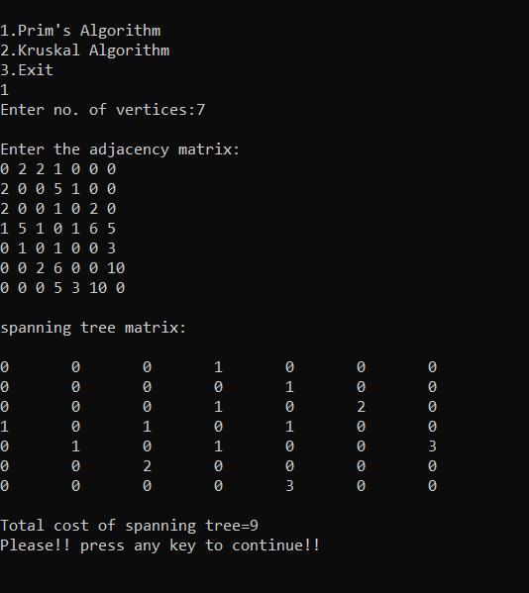
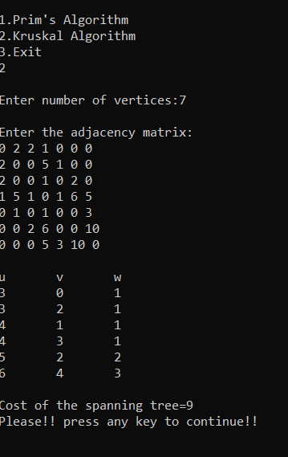
Output
Prim Algorithm
Kruskal Algorithm

Slide 8
Thank you

